Slide 1
네트워크
프로그래밍
02. nslookup
CONTENTS
Lab 02-1: nslookup
Lab 02-2: nslookup continued
Lab 02-3: DNS
휴먼지능정보공학과 201810800
이혜인

Slide 2
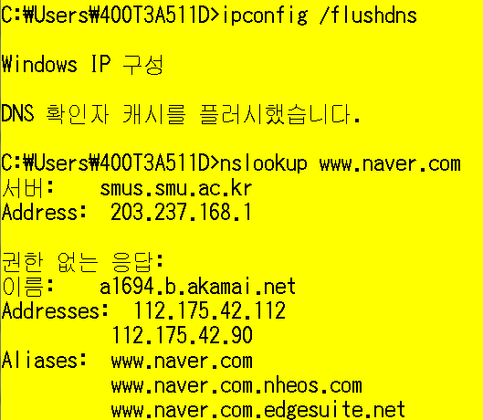
Lab 02-1: nslookup
Instructions & Questions
Use ipconfig to empty the DNS cache in your host.
ipconfig /flushdns
Open Wireshark and enter “ip.addr == your_IP_address” into the filter, where you obtain your_IP_address with ipconfig. This filter removes all packets that neither originate nor are destined to your host.
Before running nslookup in step 4, start capture using Wireshark
Open a CMD window and Run “nslookup www.naver.com”
권한 없는 응답이란 무엇인가?
Run nslookup to obtain the IP address of a Web server in Asia.
What is the IP address of that server?
Index

Slide 3
Lab 02-2: nslookup continued
Instructions
Start packet capture.
Do an nslookup on www.mit.edu
Stop packet capture.
Questions
What is the destination port for the DNS query message? What is the source port of DNS response message?
To what IP address is the DNS query message sent? Is this the IP address of your default local DNS server?
Examine the DNS query message. What “Type” of DNS query is it? Does the query message contain any “answers”?
Examine the DNS response message. How many “answers” are provided? What do each of these answers contain?
Provide a screenshot.
Index

Slide 4
Lab 02-3: DNS
Instructions
Use ipconfig to empty the DNS cache in your host.
ipconfig /flushdns
Open your browser and empty your browser cache. (With Internet Explorer, go to Tools menu and select Internet Options; then in the General tab select Delete Files.)
Open Wireshark and enter “ip.addr == your_IP_address” into the filter, where you obtain your_IP_address with ipconfig. This filter removes all packets that neither originate nor are destined to your host.
Start packet capture in Wireshark.
With your browser, visit the Web page: http://www.ietf.org
Stop packet capture.
Index

Slide 5
Lab 02-3: DNS
Questions
Locate the DNS query and response messages. Are they sent over UDP or TCP?
What is the destination port for the DNS query message? What is the source port of DNS response message?
To what IP address is the DNS query message sent? Use ipconfig to determine the IP address of your local DNS server. Are these two IP addresses the same?
Examine the DNS query message. What “Type” of DNS query is it? Does the query message contain any “answers”?
Examine the DNS response message. How many “answers” are provided? What do each of these answers contain?
Index

Slide 6
Index
Lab 02-1: nslookup

Slide 7
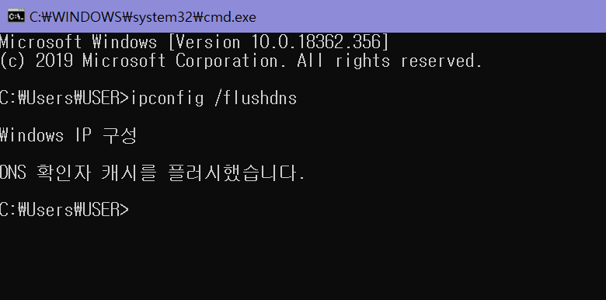
Lab 02-1: nslookup
Use ipconfig to empty the DNS cache in your host.
ipconfig /flushdns
DNS
Ipconfig /flushdns를 통해서 DNS를 삭제해준다.

Slide 8
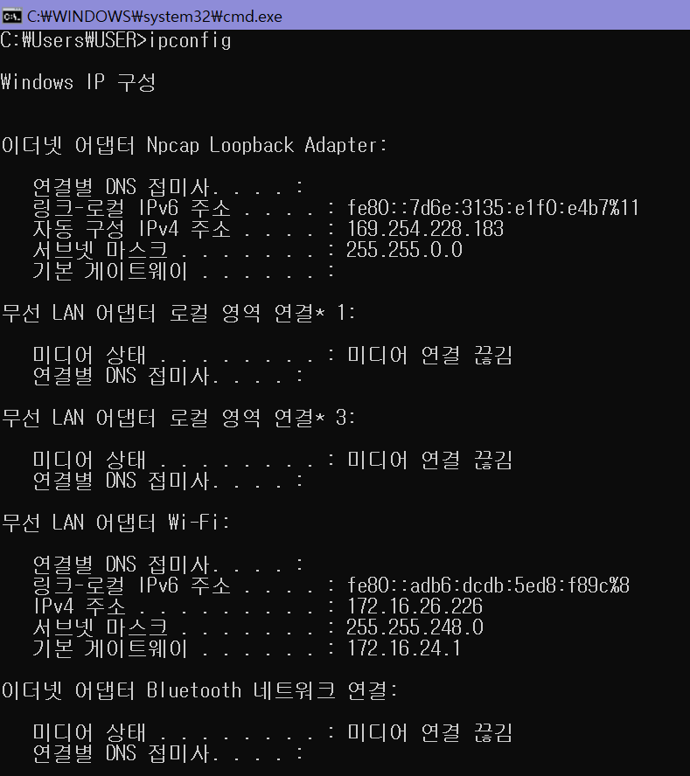
Lab 02-1: nslookup
Open Wireshark and enter “ip.addr == your_IP_address” into the filter, where you obtain your_IP_address with ipconfig. This filter removes all packets that neither originate nor are destined to your host.
DNS
Ipconfig를 통해 내 IP address를 알아냄
내 IP address : 172.16.26.226

Slide 9
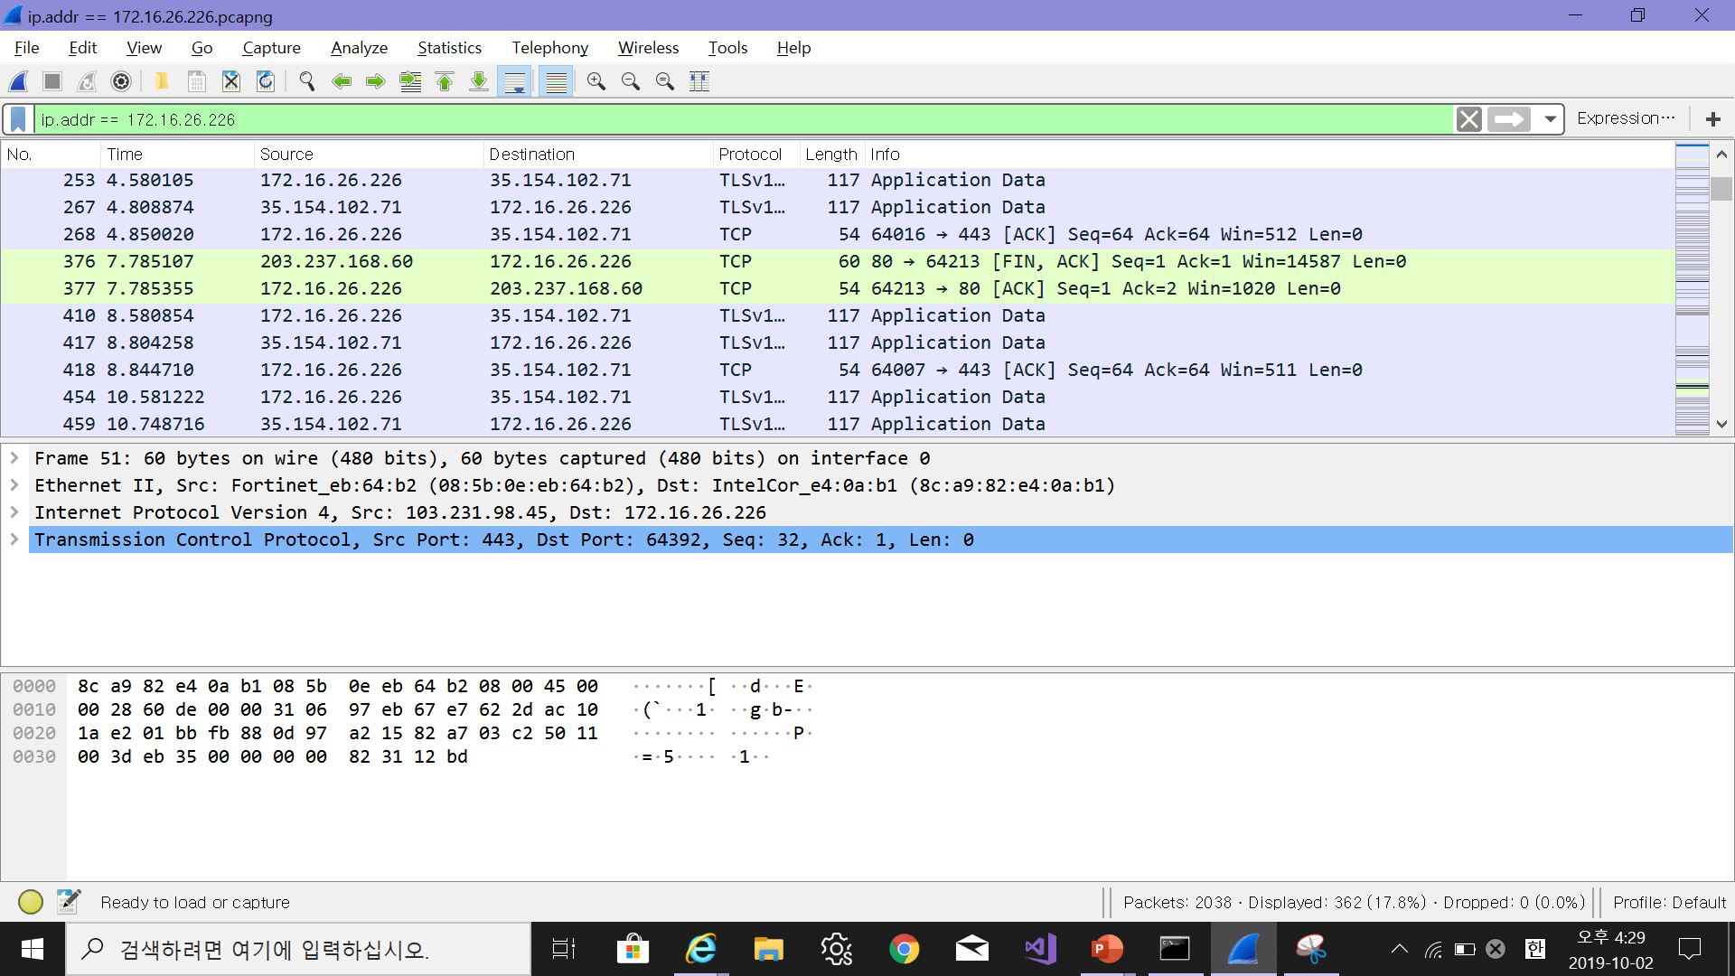
Lab 02-1: nslookup
Open Wireshark and enter “ip.addr == your_IP_address” into the filter, where you obtain your_IP_address with ipconfig. This filter removes all packets that neither originate nor are destined to your host.
DNS
→ ip.addr == 172.16.26.226 을 입력해서 Wireshark 화면을 capture

Slide 10
Lab 02-1: nslookup
Open Wireshark and enter “ip.addr == your_IP_address” into the filter, where you obtain your_IP_address with ipconfig. This filter removes all packets that neither originate nor are destined to your host.
DNS
ip.addr == 172.16.26.226을 통해 removes된 것을 확인 할 수 있다.
This filter removes all packets that neither originate nor are
destined to your host.

Slide 11
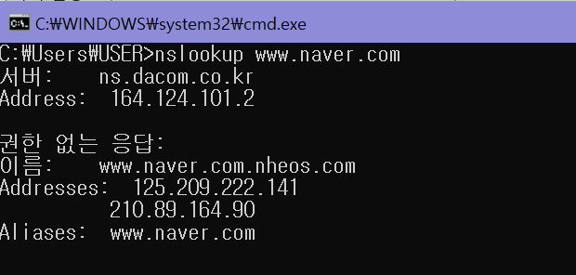
Lab 02-1: nslookup
Before running nslookup in step 4, start capture using Wireshark
Open a CMD window and Run “nslookup www.naver.com”
DNS
“nslookup www.naver.com”을 CMD Window에 작성

Slide 12
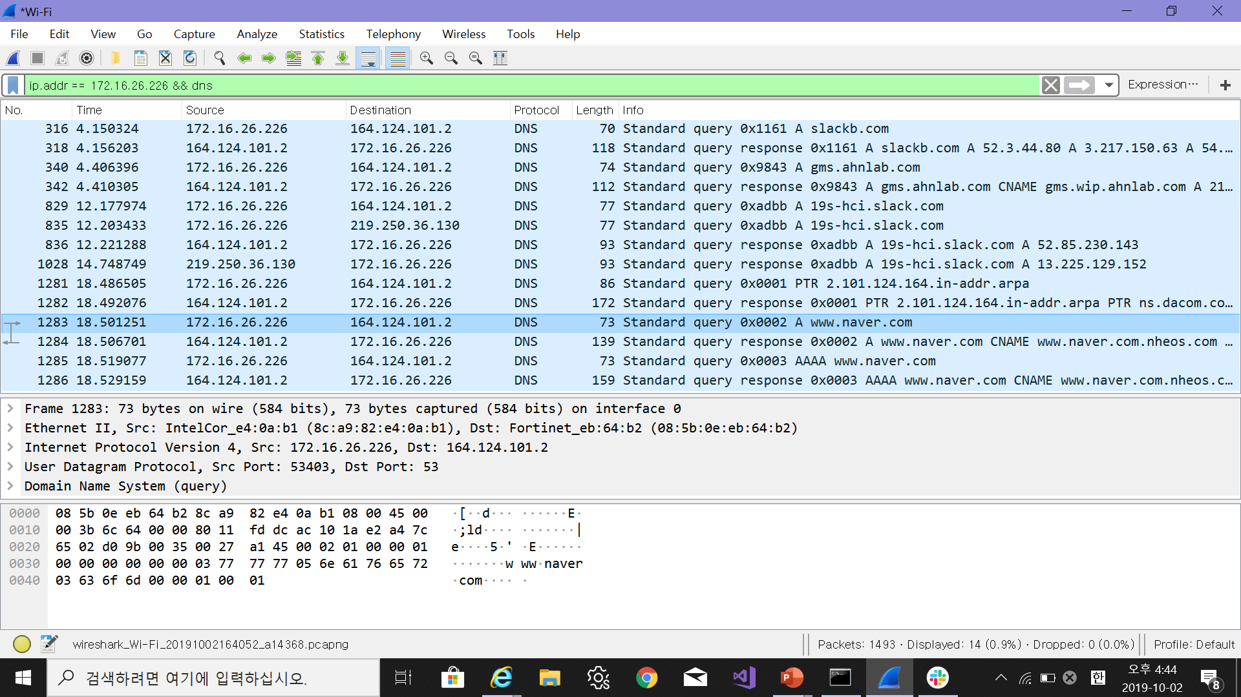
Lab 02-1: nslookup
Before running nslookup in step 4, start capture using Wireshark
Open a CMD window and Run “nslookup www.naver.com”
DNS
“nslookup www.naver.com”을 CMD window에 작성하면
Wireshark가 다음과 같이 나온다.

Slide 13
Lab 02-1: nslookup
Open a CMD window and Run “nslookup www.naver.com”
권한 없는 응답이란 무엇인가?
DNS
권한 없는 응답이란 지정된 DNS 서버에 저장되어 있는 cache가 응답한 것이다.
Cache : 지정된 정보
→ 즉, 클라이언트 컴퓨터에서 www.naver.com이라고 입력했던 정보를 지정된 DNS 서버가 저장해 두었다가 다음에 똑같은 요청을 받으면 네임 서버를 거치지 않고 저장된 cache를 통해 바로 클라이언트에 알려주는 것
→ Cache를 이용하면 요청 받을 때마다 Root DNS 서버에 요청하고 Top-level DNS 서버에 요청하고 네임서버에 요청해서 IP를 받는 것이 아니라 다이렉트로 정보를
이용할 수 있으므로 속도 면이나 비용적인 측면에서 효율을 극대화 할 수 있음

Slide 14
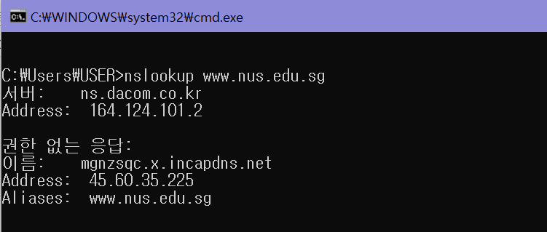
Lab 02-1: nslookup
Run nslookup to obtain the IP address of a Web server in Asia.
What is the IP address of that server?
DNS
“nslookup www.nsu.edu.sg”(싱가포르 국립대학)를
CMD window에 작성
www.nsu.edu.sg의 IP address : 45.60.35.255

Slide 15
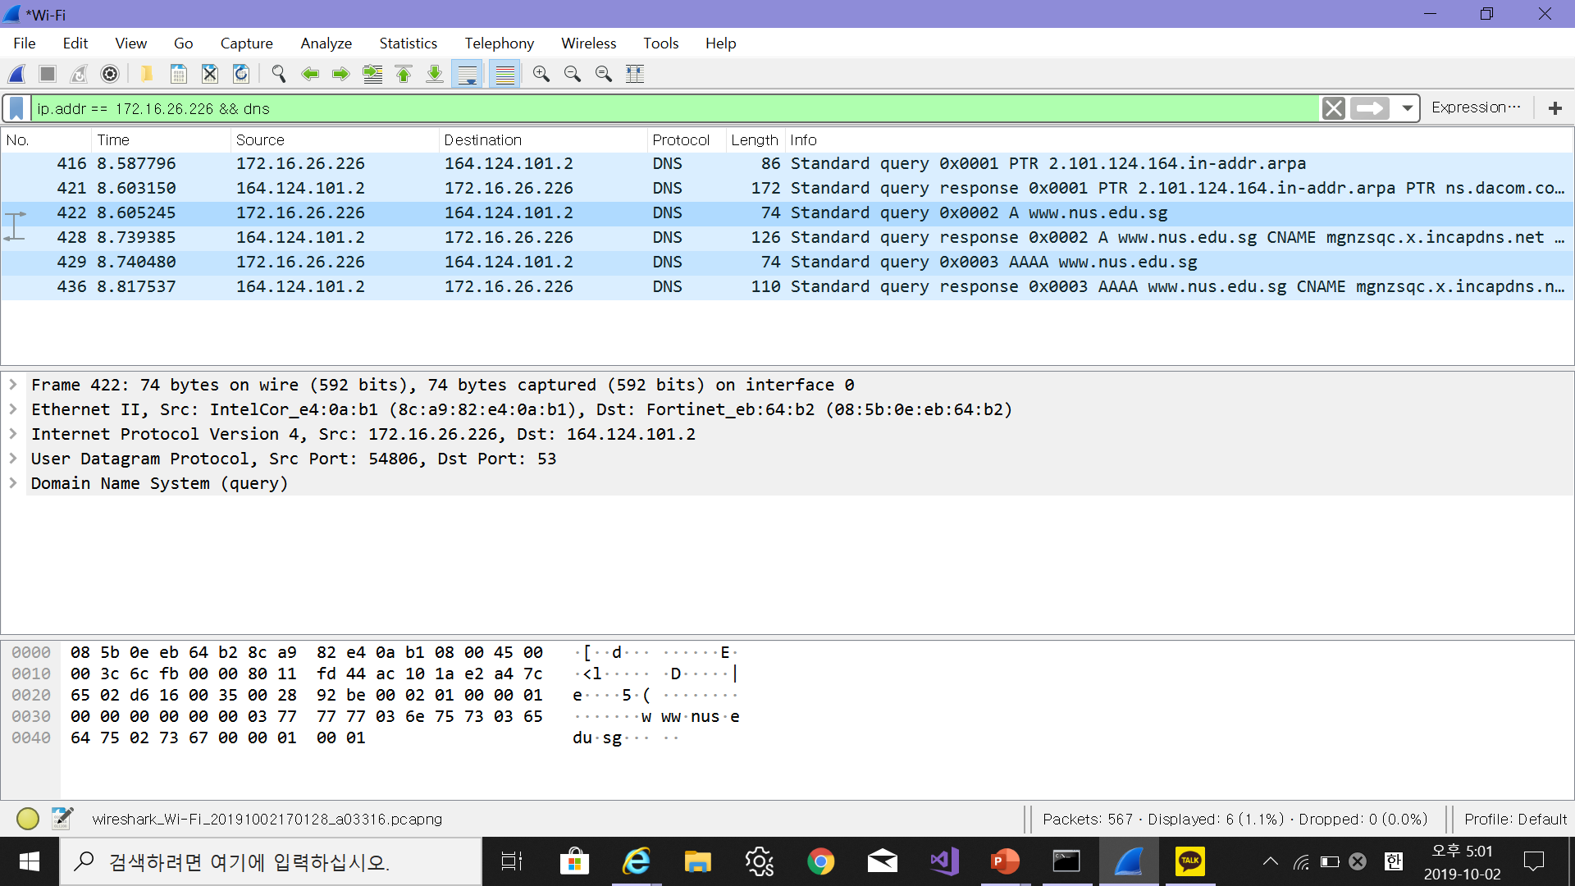
Lab 02-1: nslookup
Run nslookup to obtain the IP address of a Web server in Asia.
What is the IP address of that server?
DNS
“nslookup www.nus.edu.sg”을 CMD window에 작성하면
Wireshark가 다음과 같이 나온다.

Slide 16
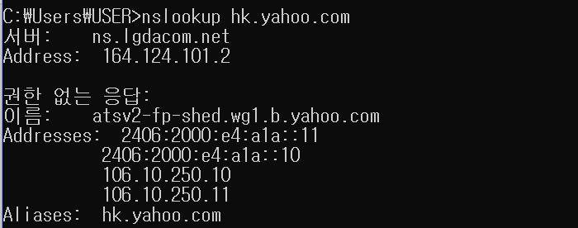
Lab 02-1: nslookup
Run nslookup to obtain the IP address of a Web server in Asia.
What is the IP address of that server?
DNS
“nslookup hk.yahoo.com”를 CMD window에 작성
hk.yahoo.com 의 IP address : 2406:2000:e4:a1a::11
2406:2000:e4:a1a::10
106.10.250.10
106.10.250.11

Slide 17
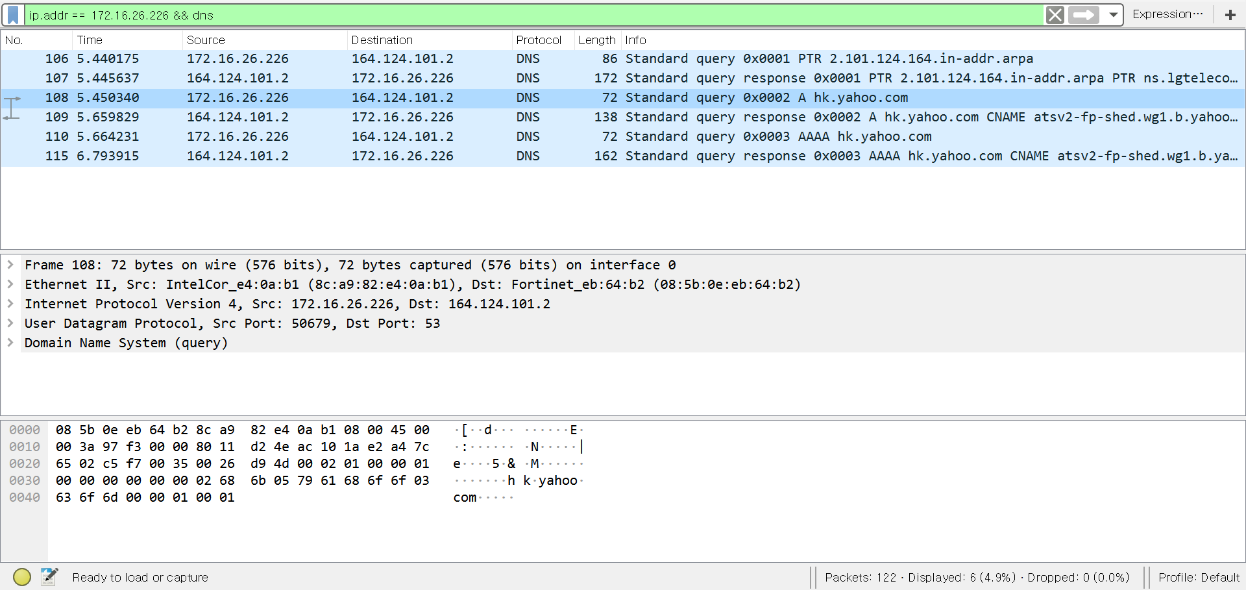
Lab 02-1: nslookup
Run nslookup to obtain the IP address of a Web server in Asia.
What is the IP address of that server?
DNS
“nslookup www.hk.yahoo.com”을 CMD window에 작성하면
Wireshark가 다음과 같이 나온다.

Slide 18
Index
Lab 02-2: nslookup continued

Slide 19
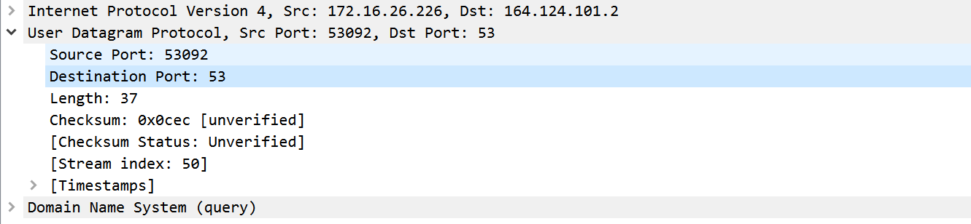
Lab 02-2: nslookup continued
What is the destination port for the DNS query message?
What is the source port of DNS response message?
DNS
Destination port for the DNS query message : 53
→ Source port of DNS response message : 53092

Slide 20
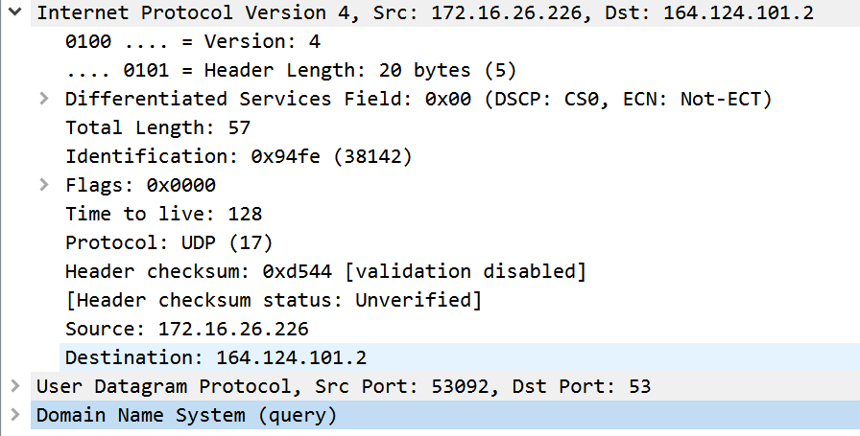
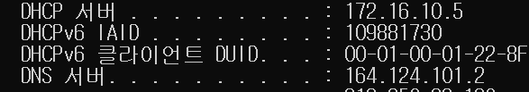
Lab 02-2: nslookup continued
To what IP address is the DNS query message sent?
Is this the IP address of your default local DNS server?
DNS
IP address(DNS query message sent) : 164.125.101.2
내 default local DNS server는 위의 IP address와 같다.
(→ipconfig한 CMD window와 Wireshark의 IP창을 통해 DNS server와
IP address가 같음을 알 수 있다.)

Slide 21
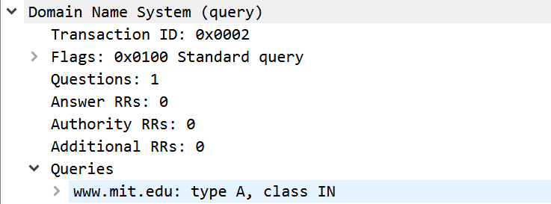
Lab 02-2: nslookup continued
Examine the DNS query message. What “Type” of DNS query is it?
Does the query message contain any “answers”?
DNS
Type of DNS query : A
Queries type A : Host name을 IP 주소에 매핑
Answer : 없다.

Slide 22
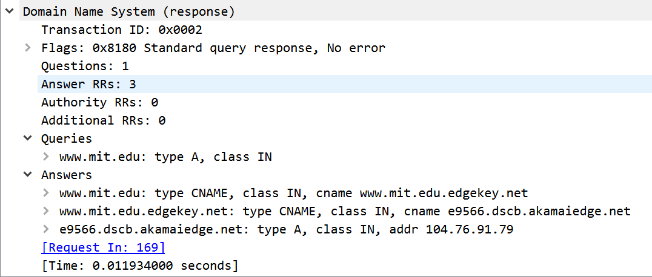
Lab 02-2: nslookup continued
Examine the DNS response message. How many “answers” are provided?
What do each of these answers contain?
DNS
How many Answer provided : 3

Slide 23
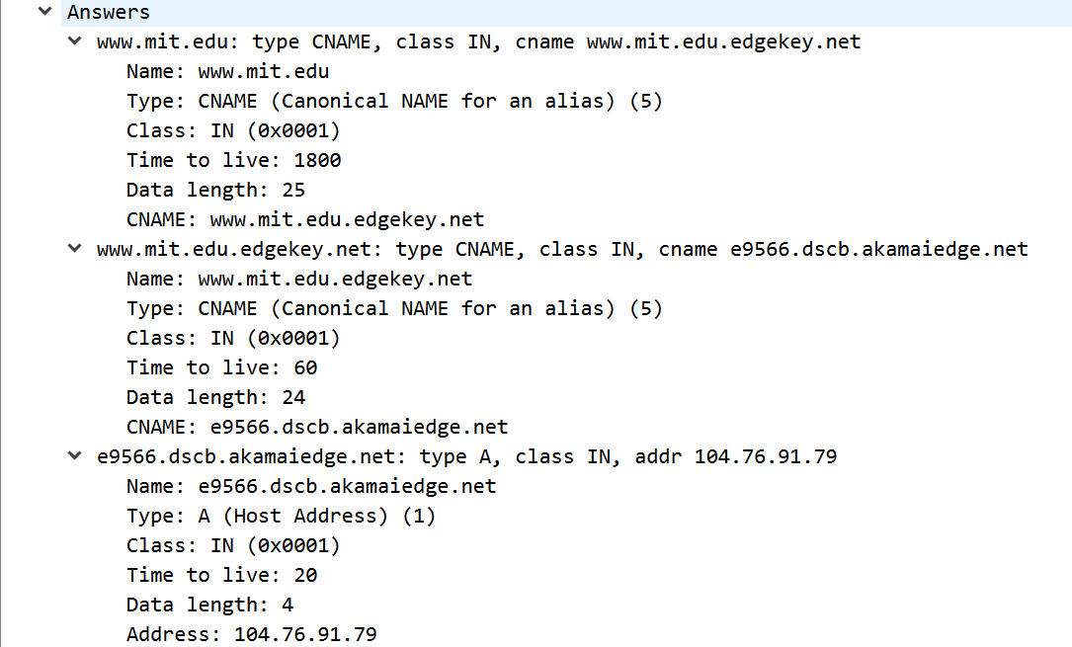
Lab 02-2: nslookup continued
Examine the DNS response message. How many “answers” are provided?
What do each of these answers contain?
DNS

Slide 24
Lab 02-2: nslookup continued
Examine the DNS response message. How many “answers” are provided?
What do each of these answers contain?
DNS
www.mit.edu: type CNAME, class IN, cname www.mit.edu.edgekey.net
Name: www.mit.edu
Type: CNAME (Canonical NAME for an alias) (5)
Class: IN (0x0001)
Time to live: 1800
Data length: 25
CNAME: www.mit.edu.edgekey.net
www.mit.edu.edgekey.net: type CNAME, class IN, cname e9566.dscb.akamaiedge.net
Name: www.mit.edu.edgekey.net
Type: CNAME (Canonical NAME for an alias) (5)
Class: IN (0x0001)
Time to live: 60
Data length: 24
CNAME: e9566.dscb.akamaiedge.net

Slide 25
Lab 02-2: nslookup continued
Examine the DNS response message. How many “answers” are provided?
What do each of these answers contain?
DNS
e9566.dscb.akamaiedge.net: type A, class IN, addr 104.76.91.79
Name: e9566.dscb.akamaiedge.net
Type: A (Host Address) (1)
Class: IN (0x0001)
Time to live: 20
Data length: 4
Address: 104.76.91.79

Slide 26
Index
Lab 02-3: DNS

Slide 27
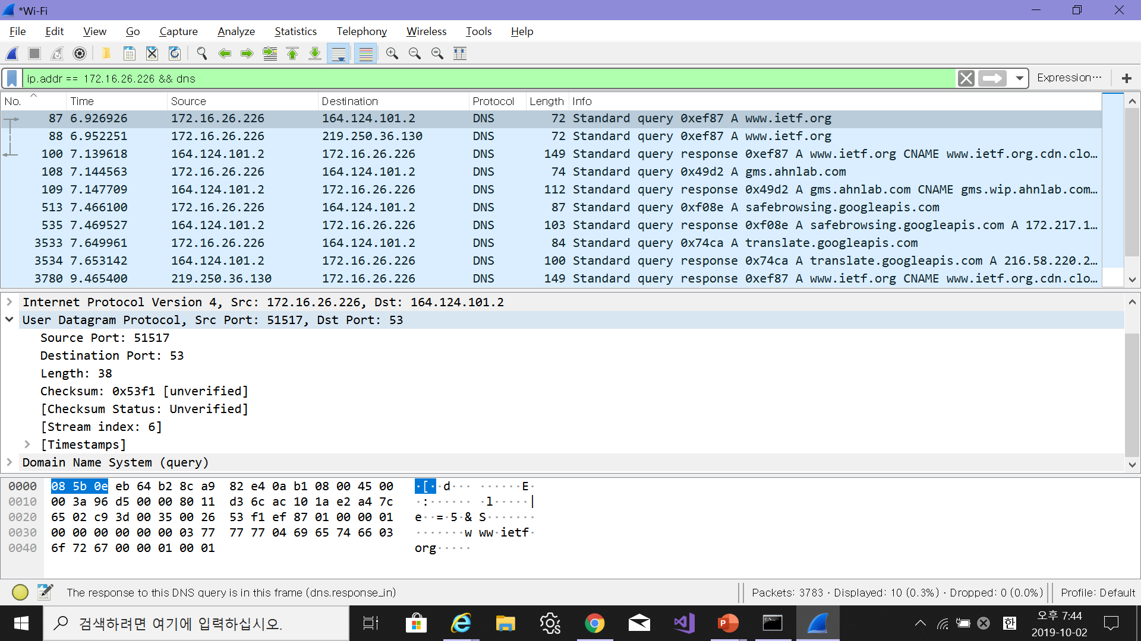
Lab 02-3: DNS
Locate the DNS query and response messages. Are they sent over UDP or TCP?
DNS
DNS(query) : UDP(User Datagram Protocol)를 거쳐서 보냄

Slide 28
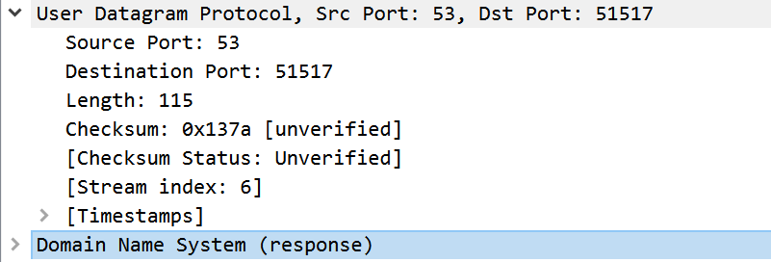
Lab 02-3: DNS
Locate the DNS query and response messages. Are they sent over UDP or TCP?
DNS
DNS(response) : UDP(User Datagram Protocol) 를 거쳐서 보냄

Slide 29
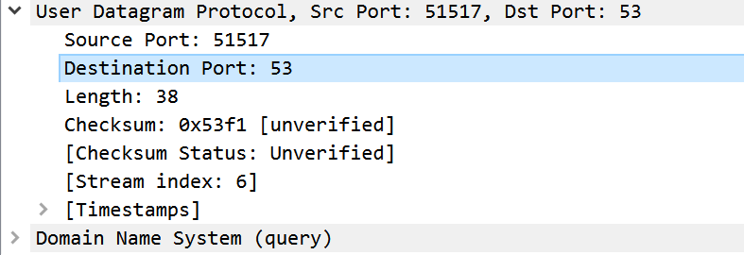
Lab 02-3: DNS
What is the destination port for the DNS query message?
What is the source port of DNS response message?
DNS
Destination port for the DNS query message : 53
→ Source port of DNS response message : 51517

Slide 30
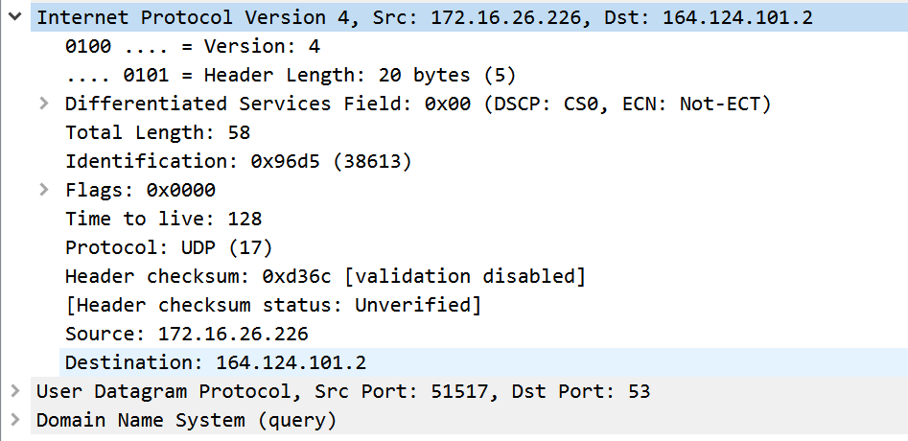
Lab 02-3: DNS
To what IP address is the DNS query message sent? Use ipconfig to determine the IP address of your local DNS server. Are these two IP addresses the same?
DNS
IP address(DNS query message sent) : 164.125.101.2
내 default local DNS serve는 위의 IP address와 같다.
(→ipconfig한 CMD window와 Wireshark의 IP창을 통해 DNS server와
IP address가 같음을 알 수 있다.)

Slide 31
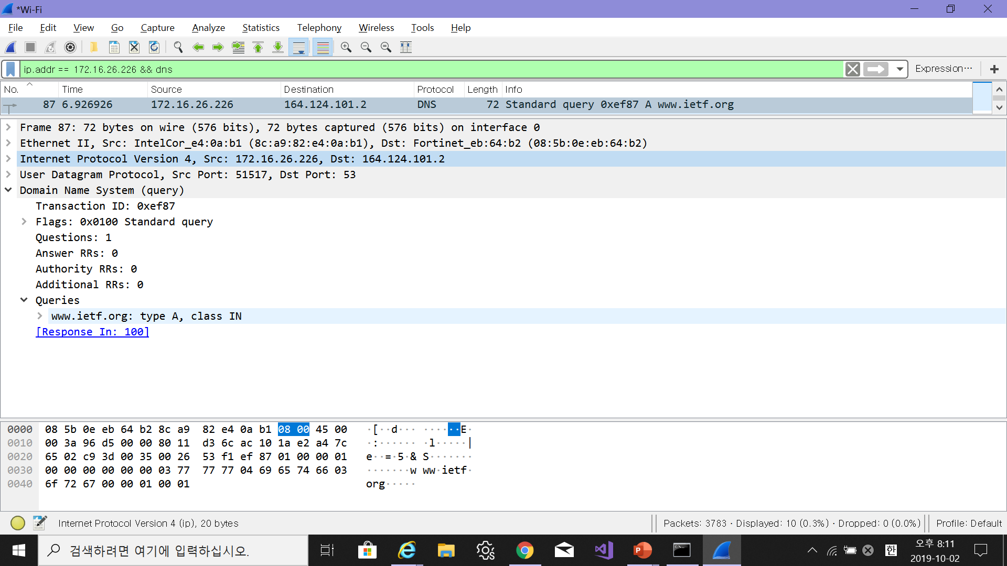
Lab 02-3: DNS
Examine the DNS query message. What “Type” of DNS query is it? Does the query message contain any “answers”?
DNS
Type of DNS query : A
Queries type A : Host name을 IP 주소에 매핑
Answer : 없다.

Slide 32
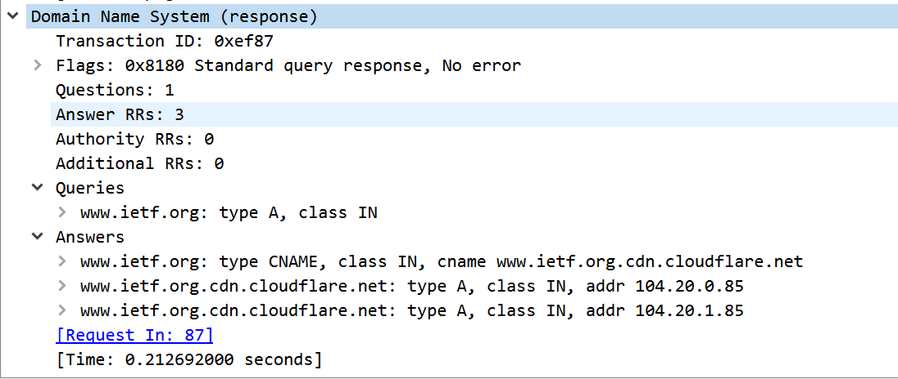
Lab 02-3: DNS
Examine the DNS response message. How many “answers” are provided? What do each of these answers contain?
DNS
How many Answer provided : 3

Slide 33
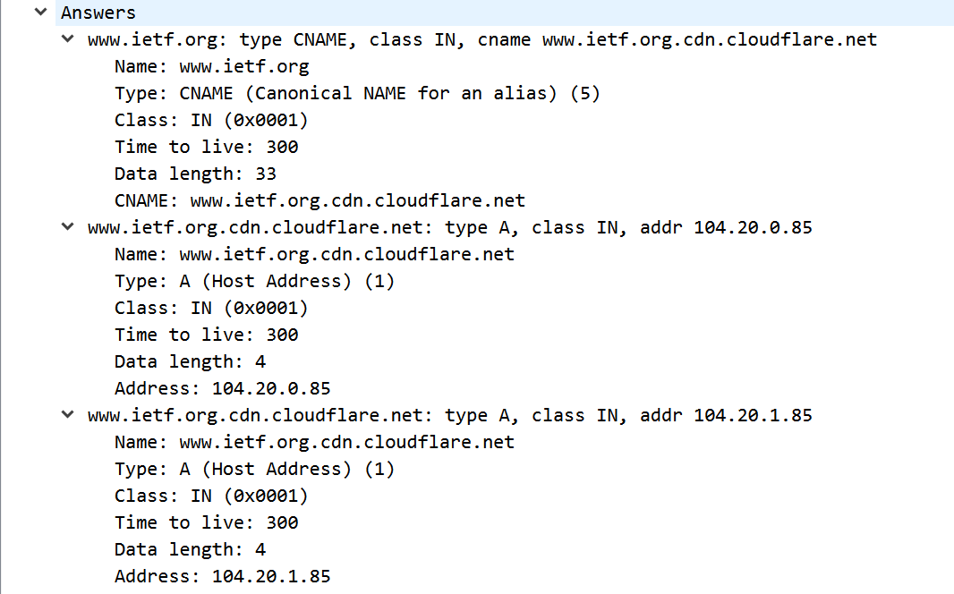
Lab 02-3: DNS
Examine the DNS response message. How many “answers” are provided? What do each of these answers contain?
DNS

Slide 34
Lab 02-3: DNS
Examine the DNS response message. How many “answers” are provided? What do each of these answers contain?
DNS
www.ietf.org: type CNAME, class IN, cname www.ietf.org.cdn.cloudflare.net
Name: www.ietf.org
Type: CNAME (Canonical NAME for an alias) (5)
Class: IN (0x0001)
Time to live: 300
Data length: 33
CNAME: www.ietf.org.cdn.cloudflare.net
www.ietf.org.cdn.cloudflare.net: type A, class IN, addr 104.20.0.85
Name: www.ietf.org.cdn.cloudflare.net
Type: A (Host Address) (1)
Class: IN (0x0001)
Time to live: 300
Data length: 4
Address: 104.20.0.85

Slide 35
Lab 02-3: DNS
Examine the DNS response message. How many “answers” are provided? What do each of these answers contain?
DNS
www.ietf.org.cdn.cloudflare.net: type A, class IN, addr 104.20.1.85
Name: www.ietf.org.cdn.cloudflare.net
Type: A (Host Address) (1)
Class: IN (0x0001)
Time to live: 300
Data length: 4
Address: 104.20.1.85

